Slide 1
Advantages and disadvantages of computer

Slide 2
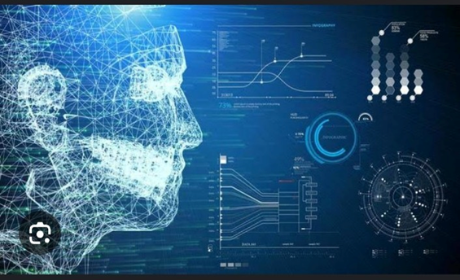
COMPUTER
C – Common
O – Operating
M – Machine
P – Particularly
U – Used For
T – Training
E – Education
R - Research

Slide 3
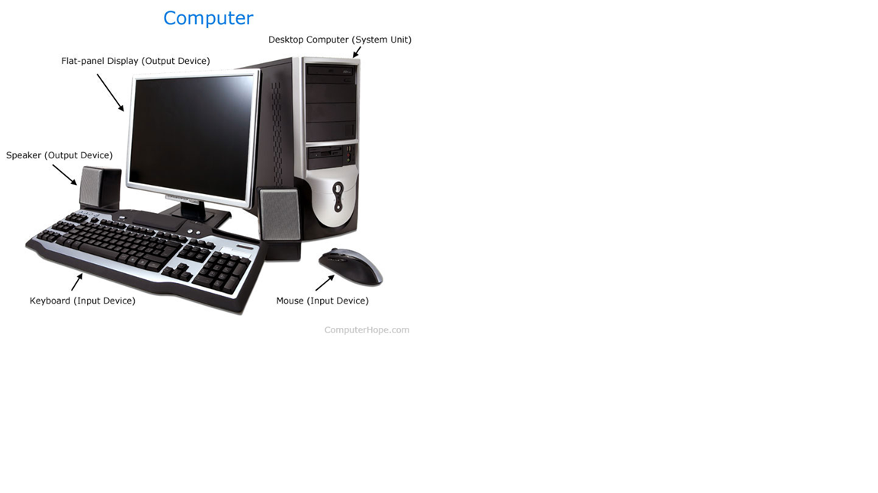
What is Computer?
Computer is an electronic device.
Which takes input from the user and gives the output after processing.

Slide 4
Characteristics
SPEED
ACCURACY
DILIGENCE
VERSATILITY
RELIABLE
LARGE STORAGE CAPACITY

Slide 5
ADVANTAGES

Slide 6

E-mail
Allow people across the world to communicate with each other by using E-mail..

Slide 7
Connection with internet
With the internet we can communicate with people throughout the globe.
We can send email , hold voice & video calls by using IM service
Also allows for instant sharing of files , we can also connect with our family , friends and with our relatives.

Slide 8
Backup & Recovery
User can backup copies of work easily ; without having to rewrite everything.
And at any time it can be recovered.

Slide 9
Education
Allows creation of a wider variety of individualized and differentiated lessons

Slide 10
DISADVANTAGES

Slide 11
Health Risks
Prolonged use of computer might lead to disorder of injuries of the wrist, neck , back and eyes .

Slide 12
Impact on Environment
Manufacturing of computer and computer wastes are harmful to the environment.
When computer junk is discarded in open ground , they release harmful chemicals like lead and mercury to the environment.
Disposed computer can cause fire.

Slide 13
Cause Poor Blood Circulation
Excess use of computer can also cause poor blood circulation because of sitting almost all the time .

Slide 14
Lack of Physical Activity
As computer are becoming more and more easy to access we are becoming unbelievable lasy and physical inactive

Slide 15
Name - Niharika Class – Information Technology section (s) Roll no. 1864 Subject – Communication skills Submitted To – Priyanshi Mam .

